Slide 1
SAP HANA on Azure Whiteboard Design Session (Trainer Deck)
Trainer names
Notes:
Welcome to the SAP HANA on Azure Whiteboard Design Session

Slide 2
Abstract and learning objectives
Abstract :
In this workshop, you will look at what is involved in deploying SAP HANA on Azure with the goals of designing for in-memory database performance, business continuity and flexibility as well as fully optimized total cost of ownership. At the end of this workshop, you will be able to better design, price and present SAP HANA on Azure solutions to your customers.
Learning objectives :
Design SAP HANA workloads on Azure in alignment with SAP HANA certification with high availability and disaster recovery.
Run Azure Pricing Calculator to price the SAP HANA landscape.
Present the solution to business/technical decision makers and handle Q&A with customer.
Prerequisite :
R-AIT344 : Architecture deep dive for SAP deployments
R-AIT333 : SAP Migration Practitioner Panel
Understanding of SAP on Azure Webinar Training and S/4HANA on Azure reference architecture
Notes:
Present the abstract, learning objectives, and prerequisites

Slide 3
Step 1: Review the customer case study
Outcome
Analyze your customer needs
Timeframe
10 minutes
Notes:
Inform students about the purpose of the first step of the design session

Slide 4
Customer situation : Contoso Group
Contoso Group is a pharmaceutical company with its headquarters based in Boston, US.
Contoso Leadership and Planning Groups wants to drastically reduce server and storage hardware in their own datacenters to minimize IT related costs. Contoso has already a number of their non-SAP systems migrated to Azure. The leadership asked Contoso IT to look into the possibility to deploy its green field S/4HANA environment to cloud.
Contoso IT decided to leverage its knowledge of the Microsoft cloud platform and existing ExpressRoute connectivity and host its SAP S/4HANA landscape in Azure.
Considering that Contoso finance and supply chain team will strongly rely on S/4HANA, the systems should be highly available and their performance must be predictable and consistent. In addition, the management team wants to leverage disaster recovery capabilities offered by Azure in order to ensure resiliency in case the primary region hosting the new deployment becomes unavailable.
Before migrating the production environment, Contoso wants to test its new deployment approach by provisioning development, and UAT environments in Azure.
Notes:
Contoso Group is a pharmaceutical company with its headquarters based in Boston, US.
Contoso Leadership and Planning Groups wants to drastically reduce server and storage hardware in their own datacenters to minimize IT related costs. Contoso has already a number of their non-SAP systems migrated to Azure. The leadership asked Contoso IT to look into the possibility to deploy its green field S/4HANA environment to cloud.
Contoso IT decided to leverage its knowledge of the Microsoft cloud platform and existing ExpressRoute connectivity and host its SAP S/4HANA landscape in Azure.
Considering that Contoso finance and supply chain team will strongly rely on S/4HANA, the systems should be highly available and their performance must be predictable and consistent. In addition, the management team wants to leverage disaster recovery capabilities offered by Azure in order to ensure resiliency in case the primary region hosting the new deployment becomes unavailable.
Before migrating the production environment, Contoso wants to test its new deployment approach by provisioning development, and UAT environments in Azure

Slide 5
Contoso CIO Vision
“Our operational dependencies on SAP applications force us to seek reasonably priced high availability and disaster recovery capabilities for our production SAP S/4HANA deployments.”
Andrew Cross, CIO, Contoso Group
Notes:
Andrew Cross, CIO of Contoso Group summarized Contoso’s objectives by stating "Our operational dependencies on SAP applications force us to seek reasonably priced high availability and disaster recovery capabilities for our production SAP S/4HANA deployments.”

Slide 6
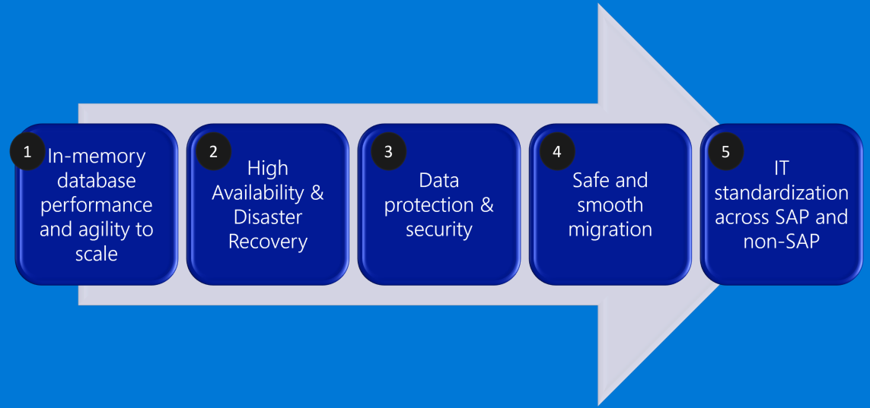
Contoso S/4HANA Deployment Priorities
Notes:
Contoso S/4HANA Deployment Priorities
- In-memory database performance and agility to scale
- High Availability & Disaster Recovery
- Data protection & security
- Safe and smooth migration with downtime minimized
- IT standardization across SAP and non-SAP

Slide 7
Contoso S/4HANA Requirements
Contoso’s requirements to size its S/4HANA with HA, DR and data protection and retention are as below.
 | HANA DB RAM requirement | Application SAPS requirement (SAPS) | High Availability for DB, application and file-share | Disaster Recovery for DB, application and file-share) | DB backup and retention period
Production | 2TiB | 15,000 | Required (No data loss, 99.95%+ VM uptime) | Required | Log backup every 30min retained for 1 day, Full daily backup for 1 month
Quality Assurance | 2TiB | 15,000 | Required (Same as Prod) | No | Full bi-weekly backup for 1 month
Development | 192GiB | No | No | No | Full bi-weekly backup for 1 month
Notes:
1. Contoso S/4HANA requirements:
Target environment:
- Sizing
- Production
- HANA DB memory requirement; 2 TiB
- Application SAPS requirements (SAPS): 15,000
- Quality Assurance
- HANA DB memory requirement; 2 TiB
- Application SAPS requirements (SAPS): 15,000
- Development
- HANA DB memory requirement; 192 GiB
- Application SAPS requirements (SAPS): none
2. Business continuity
- High Availability and Disaster Recovery
- Each proposed solution must include both high availability and disaster recovery capabilities for the Production environment (99.95% uptime)
- Each proposed solution must include high availability for the Quality Assurance environment (99.95% uptime)
- The disaster recovery solution must ensure business continuity in case of an event affecting the entire Azure datacenter hosting the Production environment
- Data protection
- No data loss allowed in the Production and the Quality Assurance environment
- Production
- HANA DB log backup taken every 30 minutes and retained for 1 day
- HANA DB full backup every night and retained for 1 month
- Quality Assurance
- HANA DB full bi-weekly backup retained for 1 month
- Development
- HANA DB full bi-weekly backup retained for 1 month

Slide 8
Discuss key design concepts (15 minutes)
Notes:
Present the key design concepts applicable to this design session

Slide 9
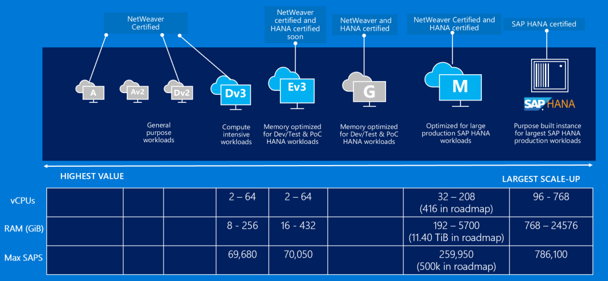
SAP on Azure – A wide variety on Compute instances
Notes:
When implementing SAP HANA-based workloads in Azure, you have the choice of deploying HANA on Azure virtual machines or bare-metal, purpose-built hardware referred to as SAP HANA on Azure (Large Instances).
There is a growing number of Azure VM SKUs certified for hosting SAP HANA including GS5 and a number of M family VM sizes (with M208ms_v2, featuring 5.7 TiB of memory and with M128s supporting scale-out configuration). There is also much larger selection of Azure VM SKUs that support non-HANA workloads (NetWeaver and non-NetWeaver products).
SAP HANA on Azure (Large Instances) involves deploying and running SAP HANA without the use of a hypervisor, with each physical server dedicated to an individual customers. The server hardware is part of a larger stamp that contain networking, compute, and storage infrastructure. Each stamp is associated with a tenant. A tenant is assigned to a single customer. A customer can have multiple tenants. SAP HANA on Azure (Large Instances) represents an example of HANA tailored data center integration (TDI) certified deployment methodology. Customers can choose from several server SKUs, ranging from 36 Intel CPU cores and 768 GB of memory to 480 Intel CPU cores and 24 TB (up to 120-TB in the scale-out configuration) of memory. Two different classes of hardware divide the SKUs into:
S72, S72m, S96, S144, S144m, S192, S192m, and S192xm, which are referred to as the "Type I class" of SKUs.
S384, S384m, S384xm, S384xxm, S576m, S576xm S768m, S768xm and S960m, which are referred to as the "Type II class" of SKUs.

Slide 10
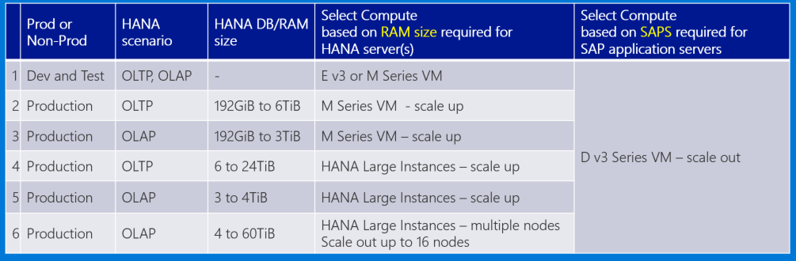
Pick Azure Compute for HANA and Application Servers
Choose right Azure Compute based on :
Scenario (OLTP or OLAP)
OLTP : S/4HANA, Business Suite on HANA, NetWeaver
OLAP : BW on HANA, BW/4HANA, Enterprise DWH, Sidecar
Required RAM for HANA and SAPS for application servers
Notes:
Sizing of HANA and application servers should be based on the two primary set of criteria:
The intended workload: OLTP (S/4HANA, Business Suite on HANA, and NetWeaver) or OLAP (BW on HANA, BW/4HANA, Enterprise DWH, Sidecar).
Memory (HANA) and SAPS (application servers)
Environment (production or non-production)
Architecture (scale-up or scale-out)

Slide 11
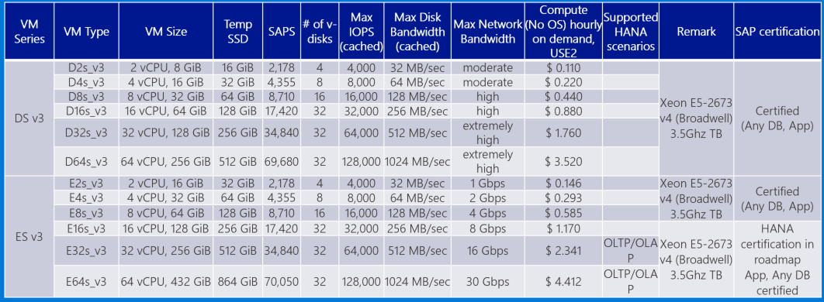
Choose Azure VM types to meet sizing requirements
SAP Note 1928533 and https://docs.microsoft.com/en-us/azure/virtual-machines/windows/sizes-memory
Notes:
Review performance characteristics referenced in the table on the current slide. Point out that some of the VM types are on the certification roadmap for SAP HANA. Explain that, in order to implement SAP workloads on Azure in a supported manner, customers should following SAP certified configurations, which consist of a combination of the following four elements:
- SAP product
- Operating system
- RDBMS
- Azure offering, including Azure VM SKU and (in case of HANA) SAP HANA on Azure (Large Instances)
For additional information, refer to SAP Note #1928533 - SAP Applications on Azure: Supported Products and Azure VM types

Slide 12
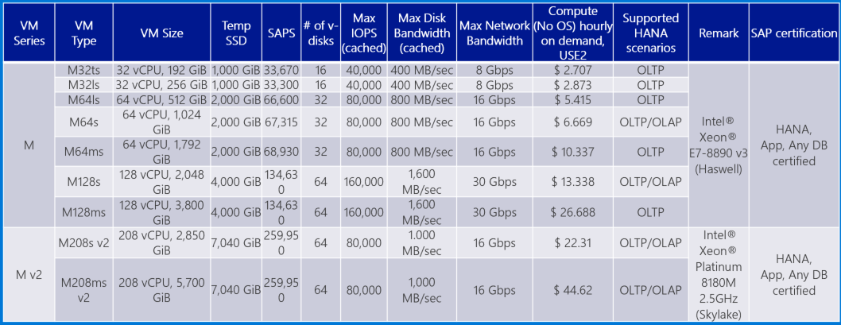
Choose Azure VM types to meet sizing requirements (continued)
SAP Note 1928533 and https://docs.microsoft.com/en-us/azure/virtual-machines/windows/sizes-memory
Notes:
Review performance characteristics referenced in the table on the current slide. Point out that some of the VM types are on the certification roadmap for SAP HANA. Explain that, in order to implement SAP workloads on Azure in a supported manner, customers should following SAP certified configurations, which consist of a combination of the following four elements:
- SAP product
- Operating system
- RDBMS
- Azure offering, including Azure VM SKU and (in case of HANA) SAP HANA on Azure (Large Instances)
For additional information, refer to SAP Note #1928533 - SAP Applications on Azure: Supported Products and Azure VM types

Slide 13
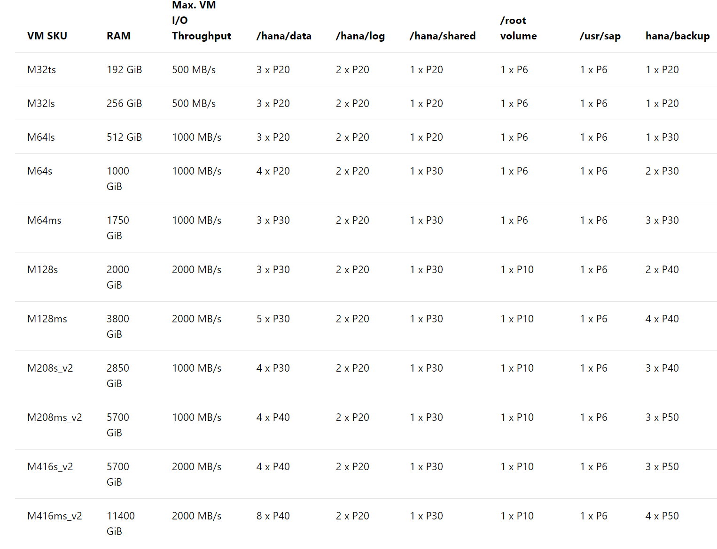
Premium Storage config to run HANA on M Series VM
Enable Write Accelerator
Link to documentation
Notes:
As per SAP Note #2015553, Premium Storage is required for all database related files with exception of A-series VM SKUs (including Standard_A5, Standard_A6, Standard_A7, Standard_A8, Standard_A9, Standard_A10, Standard_A11) and D-series VM SKUs (including Standard_D11, Standard_D12, Standard_D13, and Standard_D14).
Storage latency is critical for DBMS systems, even for SAP HANA, which, for the most part, keep data in-memory. The critical path in storage is usually around the transaction log writes of the DBMS systems. Effectively, it is mandatory to leverage Azure Premium Disks for /hana/data and /hana/log volumes. In order to achieve the minimum throughput of /hana/log and /hana/data as desired by SAP, you might need to to build a RAID 0 using MDADM or LVM over multiple Azure Premium Storage disks. And use the RAID volumes as /hana/data and /hana/log volumes. As stripe sizes for the RAID 0 the recommendation is to use:
- 64 KB or 128 KB for /hana/data
- 32 KB for /hana/log
Premium Storage offers the following caching options:
- None
- Read
- Read/write
- None + Write Accelerator, which is only for Azure M-Series VMs
- Read + Write Accelerator, which is only for Azure M-Series VMs
Premium Storage specific recommendation is to use Read caching for disks hosting SAP database data files and No caching for the disks containing SAP database log files. The same principle applies to SAP HANA, where the caching for volumes using Azure Premium Storage should be set as follows:
- /hana/data - no caching
- /hana/log - no caching (with exception for M-Series VMs)
- /hana/shared - read caching
For M-Series deployments, Microsoft recommends that you use Azure Write Accelerator for your DBMS deployment. As a matter of fact, SAP HANA certification for Azure M-Series virtual machines requires that Azure Write Accelerator is enabled for the /hana/log volume. Note that there are limits of Azure Premium Storage VHDs per VM that can be supported by Azure Write Accelerator. The current limits are:
- 16 VHDs for an M128xx and M416xx VM
- 8 VHDs for an M64xx and M208xx VM
- 4 VHDs for an M32xx VM

Slide 14
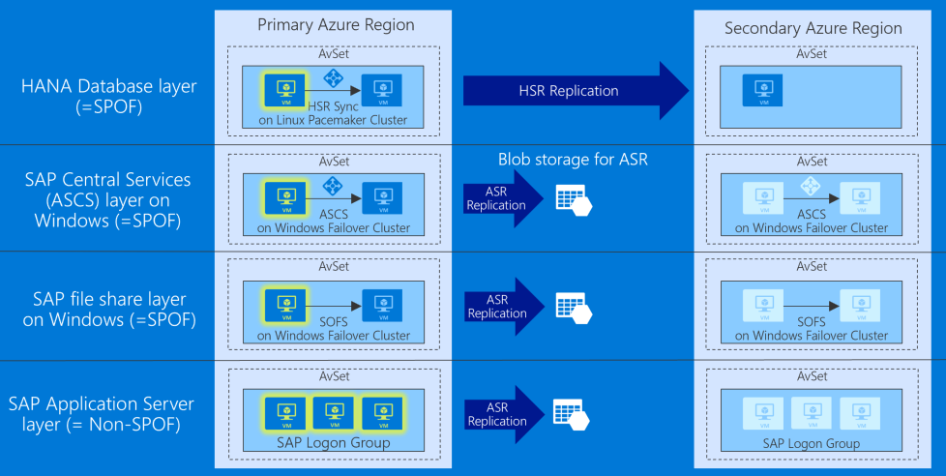
S/4HANA HA in Availability Set and DR across Regions
Notes:
The current slide represents the traditional design, which relies on well-established concept of availability sets and leverages a pair of Azure regions in the same geography. An Azure Availability Set is a logical grouping capability that helps ensure that the VM resources that you place within the Availability Set are failure-isolated from each other when they are deployed within an Azure datacenter. Azure ensures that the VMs you place within an Availability Set run across multiple physical servers, compute racks, storage units, and network switches. This configuration is referred to as placements in different update and fault domains. These placements usually are within an Azure datacenter. Assuming that power source and network issues would affect the datacenter that you are deploying, all your capacity in one Azure region would be affected.
Note that it is important to consider high availability and disaster recovery provisions separately for each component of this design:
- HANA Database layer - both high availability and disaster recovery is implemented by using HANA System Replication (synchronous or asynchronous, depending on the option). In case of synchronous replication, the high availability functionality relies additionally on Linux-based Pacemaker clustering.
- SAP Central Services (ASCS) layer - high availability is implemented by using operating system-level clustering (either Windows Server Failover Clustering or Linux-based Pacemaker clustering, depending on the underlying operating system). Disaster recovery relies across Azure regions on Azure Site Recovery, which replicates virtual disks of cluster members to the secondary site. Azure Site Recovery is also used to orchestrate failover between sites.
- SAP file share layer - high availability of the sapmnt share is implemented by using either Windows-based file share (based on Windows Storage Spaces Direct cluster hosting Scale-Out File Server) or Linux-based NFS mount (based on Azure NetApp Files or Linux Distributed Replicated Block Device). Disaster recovery relies on Azure Site Recovery, which replicates the file sharing infrastructure to the secondary site. When using Azure NetApp Files NFS-based approach, NetApp offers a SaaS based solution called NetApp Cloud Sync. You can use any file based-copy tool (such as rsync) to replicate data to the secondary site (including file or folder permissions).
- SAP Application Server layer - high availability is implemented by simply deploying multiple application servers. Disaster recovery across Azure regions relies on Azure Site Recovery, which replicates virtual disks of application servers to the secondary site. Azure Site Recovery is also used to orchestrate failover between sites.

Slide 15
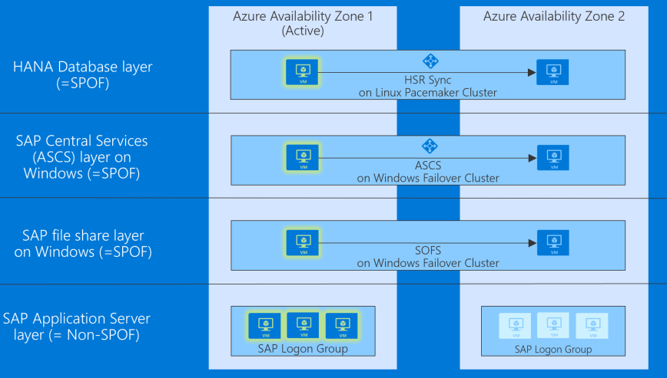
S/4HANA HA and DR across Availability Zones
Notes:
The current slide represents a different design that takes advantage of availability zones, representing separate, physically isolated data centers within the same region. The placement of datacenters that represent Azure Availability Zones constitutes a compromise between delivering acceptable network latency to services deployed in different zones, and a distance between datacenters. The distance matters because even though majority of destructive events are not likely to affect the infrastructure of all Availability Zones in the same region, history offers examples of larger scale disasters that could have such impact. To account for such occurrences, organizations might have the minimum distance requirement between the location of their production and disaster recovery sites. For most Azure customers, the minimum distance definition necessitates the use of two or more Azure regions.
Note that it is important to consider high availability and disaster recovery provisions separately for each component of this design. In this case, the highly available production components are distributed across Availability Zone 1 and Availability Zone 2:
- HANA Database layer is hosted by a Linux Pacemaker cluster containing an active VM instance residing in Availability Zone 1 and standby VM instance residing in Availability Zone 2, with HANA Synchronous replication between nodes of the cluster. Clustering is implemented by using Pacemaker.
- ASCS layer hosted by a Windows cluster contains an active VM instance residing in Availability Zone 1 and a standby VM instance residing in Availability Zone 2.
- SAP file share layer on Windows cluster contains an one VM node residing in Availability Zone 1 and another VM node residing in Availability Zone 2.
- SAP Application Server layer consists of a PAS server VM in Availability Zone 1 and AAS in Availability Zone 2. Clustering is not used in this case since high availability is built-into the PAS and AAS functionality.

Slide 16
Additional Note (Design)
Key design components :
HANA System Replication, Windows/Linux cluster, Windows SOFS or Linux DRBD or Azure NetApp Files, Azure Site Recovery, VNET Hub & Spoke topology
Discuss following two HA/DR options and choose one
HA in an Availability Set and DR across Regions
DR replica can coexist with QA in the second Region
HA/DR across Availability Zones
Include network solutions as well
Add ExpressRoute for end user access and consider geo redundancy
Add Site-to-Site VPN for remote admin & monitoring
Don’t forget other components :
Blob storage for backup retention, jump box, DNS, patching, backup, monitoring, Cloud Witness or SBD Disk
Notes:
1. Key design components:
- HANA System Replication
- Windows/Linux clusters
- Windows SOFS or Linux DRBD or Azure NetApp Files
- Azure Site Recovery
- VNet Hub & Spoke topology
2. Two primary HA/DR options
- HA in an Availability Set and DR across regions (DR replica can coexist with QA in the second region)
- HA/DR across Availability Zones
3. Networking considerations
- ExpressRoute for end user access with geo-redundancy provisions
- Site-to-Site VPN for remote administration and monitoring
4. Additional infrastructure considerations
- Blob storage for backup retention
- Jump-box
- DNS
- Patching
- Backup
- Monitoring
- Cluster arbitration (Cloud Witness and SBD)

Slide 17
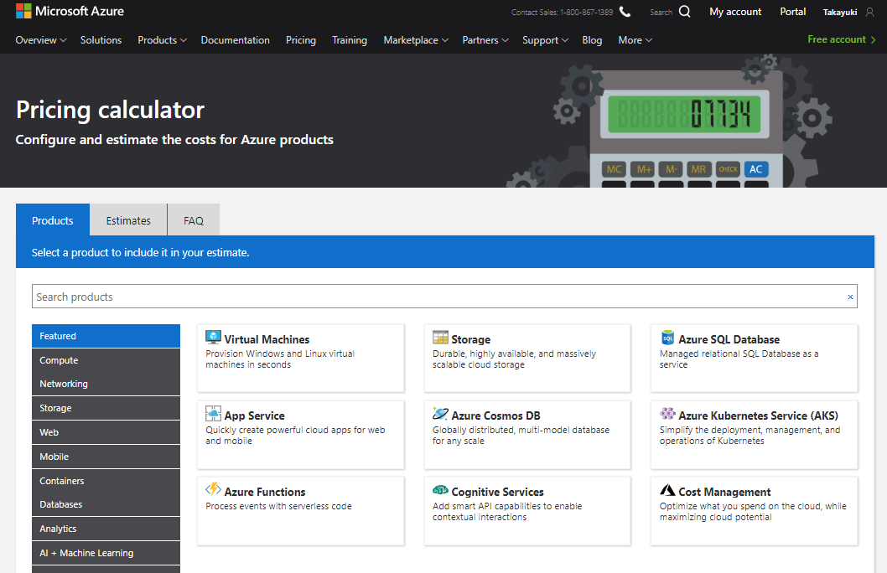
Azure Pricing Calculator
Notes:
Demonstrate the use of Azure Pricing Calculator as you present this slide.

Slide 18
Additional Note (Pricing)
Use Reserved VM Instances option if it helps save costs
Consider best OS licensing option(s)
Common NOT to include Windows license costs because of AHUB
Can include Linux OS subscription costs from Azure marketplace
Create assumptions for ExpressRoute bandwidth
Make sure to include a minimum amount of Azure support
e.g. Azure Professional Direct
Notes:
Pricing
- Use Azure Pricing Calculator
- Use Reserved VM Instances option if it helps save costs
- Consider best OS licensing option(s):
- It is common NOT to include Windows license costs because of Azure Hybrid Use Benefits
- Linux OS subscription costs can be based on Azure Marketplace
- Provide assumptions for ExpressRoute bandwidth
- Make sure to include the required minimum level of Azure support (e.g. Azure Professional Direct, whenever applicable)

Slide 19
Customer needs and objections
Is the proposed solution fully certified by SAP ?
Does the proposal meet Contoso business continuity requirements? What if there’s outage on VM or storage? How can we restore from backup? How can we failover the landscape in case of an outage?
There’re legacy systems on-prem that need to interact with S/4HANA in cloud. How can we minimize performance impact in cross-premises scenarios?
Can we change the size of the environment if sizing requirements change in future?
Is there anything not included in the results of Azure Pricing Calculator?
CFO is asking for cost saving even further. What can we do to optimize the cost? What are our options?
Notes:
Is the proposed solution fully certified by SAP?
Does the proposal meet Contoso business continuity requirements? What if there’s outage on VM or storage? How can we restore from backup? How can we failover the landscape in case of an outage?
There’re legacy on-prem systems that need to interact with S/4HANA in cloud. How can we minimize performance impact in cross-premises scenarios?
Can we change the size of the environment if sizing requirements change in future?
Is there anything not included in the results of Azure Pricing Calculator?
CFO is asking for cost saving even further. What can we do to optimize the cost? What are our options?

Slide 20
Step 2: Design and price the solution
Outcome
Design a solution and prepare to present the solution to the target customer audience in a 15-minute chalk-talk format.
Timeframe
50 minutes
Business needs (10 minutes) | Respond to questions outlined in your guide and list the answers on a flipchart
Design (30 minutes) | Design a solution for as many of the stated requirements as time allows. Show the solution on a flipchart
Prepare (10 minutes) | Identify any customer needs that are not addressed with the proposed solution Identify the benefits of your solution Determine how you will respond to the customer’s objections Prepare for a 15-minute presentation to the customer
Notes:
Inform students about the purpose of the second step of the design session

Slide 21
Step 3: Present the solution
Outcome
Present a solution to the target customer in a 15-minute chalk-talk format
Timeframe
30 minutes (15 minutes for each team to present and receive feedback)
Directions
Pair with another table
One table is the Microsoft team and the other table is the customer
The Microsoft team presents their proposed solution to the customer
The customer asks one of the objections from the list of objections in the case study
The Microsoft team responds to the objection
The customer team gives feedback to the Microsoft team
Notes:
Inform students about the purpose of the third step of the design session

Slide 22
Wrap-up
Outcome
Identify the preferred solution for the case study
Identify solutions designed by other teams
Timeframe
20 minutes
Notes:
Keep track of time and coordinate students’ activities

Slide 23
Preferred target audience
Business Development Manager (BDM) or Application Sponsor (CFO)
Funds projects & apps
Most interested in public cloud
Business Unit IT / Developers (Director of SAP Business Analysts, Director of SAP Operations)
Reports to BDM and is responsible for coding and testing apps
Big influencer of public cloud strategy
Central IT (VP of IT Operations)
Reports into CIO and responsible for operating datacenter
Concerned about shadow IT created issues: security/compliance, server sprawl, and lack of control
Notes:
The preferred target audience includes:
- Business Development Manager (BDM) or Application Sponsor (CFO)
- Funds projects & apps
- Most interested in public cloud
- Business Unit IT / Developers (Director of SAP Business Analysts, Director of SAP Operations)
- Reports to BDM and is responsible for coding and testing apps
- Big influencer of public cloud strategy
- Central IT (VP of IT Operations)
- Reports into CIO and responsible for operating datacenter
- Concerned about shadow IT created issues: security/compliance, server sprawl, and lack of control

Slide 24
Preferred solutions
Azure VMs – HA in Availability Set and DR across Regions
Azure VMs - HA and DR across Availability Zones
Notes:
Explain that the preferred solution will consist of two options:
Azure VMs – HA in Availability Set and DR across Regions
Azure VMs - HA and DR across Availability Zones

Slide 25
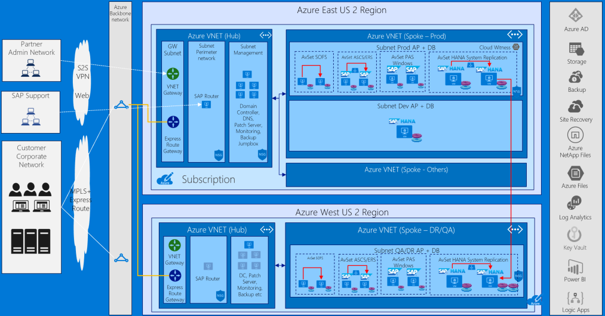
S/4HANA (1) : HA in Availability Set and DR across Regions
Notes:
The first option (Azure VMs – HA in Availability Set and DR across Regions) represents the traditional design, which relies on well-established concept of availability sets and leverages a pair of Azure regions in the same geography. An Azure Availability Set is a logical grouping capability that helps ensure that the VM resources that you place within the Availability Set are failure-isolated from each other when they are deployed within an Azure datacenter. Azure ensures that the VMs you place within an Availability Set run across multiple physical servers, compute racks, storage units, and network switches. This configuration is referred to as placements in different update and fault domains. These placements usually are within an Azure datacenter. Assuming that power source and network issues would affect the datacenter that you are deploying, all your capacity in one Azure region would be affected.

Slide 26
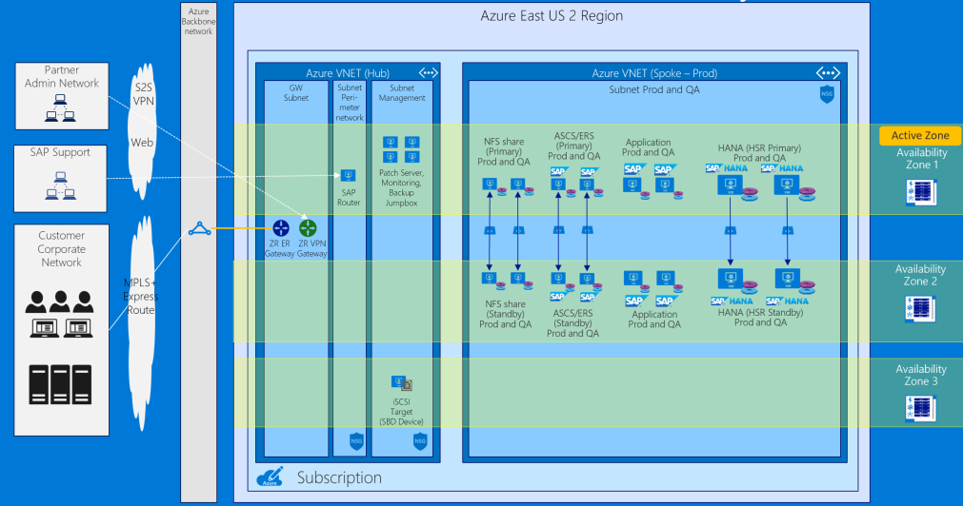
S/4HANA (1) : HA in Availability Set and DR with Availability Zones
Notes:
The second option (Azure VMs - HA and DR across Availability Zones) takes advantage of the availability zones, representing separate, physically isolated data centers within the same region. The placement of datacenters that represent Azure Availability Zones constitutes a compromise between delivering acceptable network latency to services deployed in different zones, and a distance between datacenters. The distance matters because even though majority of destructive events are not likely to affect the infrastructure of all Availability Zones in the same region, history offers examples of larger scale disasters that could have such impact. To account for such occurrences, organizations might have the minimum distance requirement between the location of their production and disaster recovery sites. For most Azure customers, the minimum distance definition necessitates the use of two or more Azure regions.

Slide 27
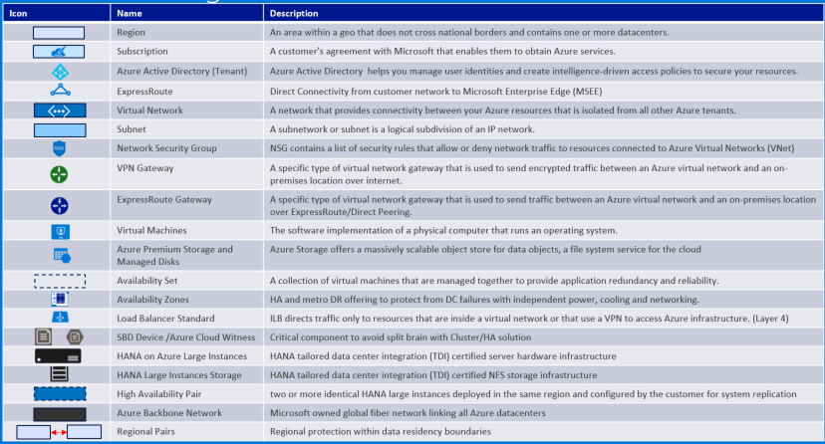
Baseline Knowledge for SAP as a Service on Azure
Notes:
Reference this slide when describing both options of the preferred solution

Slide 28
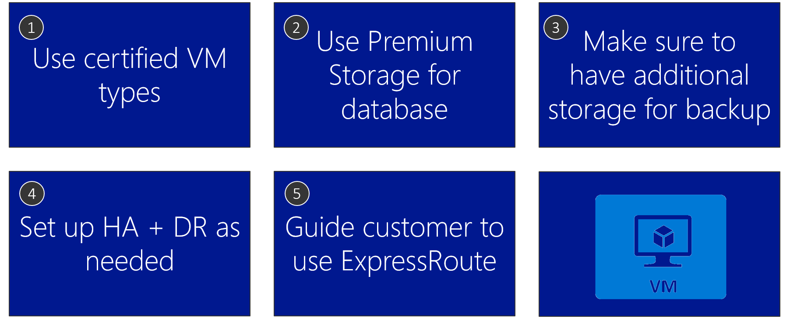
Azure VM design tips
Notes:
Describe Azure VM design tips, focusing in particular on those presented on the current slide.

Slide 29
S/4HANA on Azure : T-Shirt Pricing
# | S/4HANA DB Size | Cost Conscious or HA/DR | Estimated monthly Azure cost (USD) | Link to BOM
1 | 192GB | Cost Conscious | $5,568.48 | Link
2 | 256GB | Cost Conscious | $5,746.62 | Link
3 | 512GB | Cost Conscious | $7,630.41 | Link
4 | 1TB | Cost Conscious | $9,631.73 | Link
5 | 1.75TB | Cost Conscious | $11,551.01 | Link
6 | 2TB | Cost Conscious | $12,051.57 | Link
7 | 3TB | Cost Conscious | $17,971.85 | Link
8 | 4TB | Cost Conscious | $20,978.26 | Link
9 | 6TB | Cost Conscious | $29,892.95 | Link
10 | 192GB | HA/DR | $10,131.37 | Link
11 | 256GB | HA/DR | $10,266.94 | Link
12 | 512GB | HA/DR | $12,588.07 | Link
13 | 1TB | HA/DR | $15,739.16 | Link
14 | 1.75TB | HA/DR | $22,267.93 | Link
15 | 2TB | HA/DR | $24,006.33 | Link
16 | 3TB | HA/DR | $36,150.50 | Link
17 | 4TB | HA/DR | $41,375.19 | Link
18 | 6TB | HA/DR | $58,892.93 | Link
Notes:
The pricing consists of two main categories: *HA/DR* and *cost conscious* (without HA/DR). Each quote includes cost of Production, QA, and Development environments, as well as it takes into account compute, storage, networking, SUSE OS/support, Azure Professional Direct Support (which is, at minimum, required when deploying SAP production solutions in Azure). The *cost conscious* pricing doesn’t include HA nor DR (single VM) and assumes retention of daily backups of Production for one month, along with biweekly QA and Dev backups. The *HA/DR* option includes Standard Load Balancer in the primary site and a DR replica in the secondary site, with retention of daily backups of Production for one month, monthly and quarterly for one year, along with monthly backups of QA and Dev monthly retained for one year.
Note :
All options include Prod, QA, Dev, Storage, Management, Network, SUSE OS/support, Azure Professional Direct Support and full SAP certification
All options does NOT include software licenses of SAP, Backup, Monitoring and Windows OS (because of AHUB)
Cost conscious doesn’t include HA nor DR (single VM) | backup retention : PRD daily for one month (= x 31), QA and Dev twice per month (= x 2)
HA/DR include local HA in Availability Set with Standard Load Balancer and DR replica in another region | backup retention PRD daily for one month, monthly and quarterly for one year (= x 47), QA and Dev monthly for one year (= x 12)

Slide 30
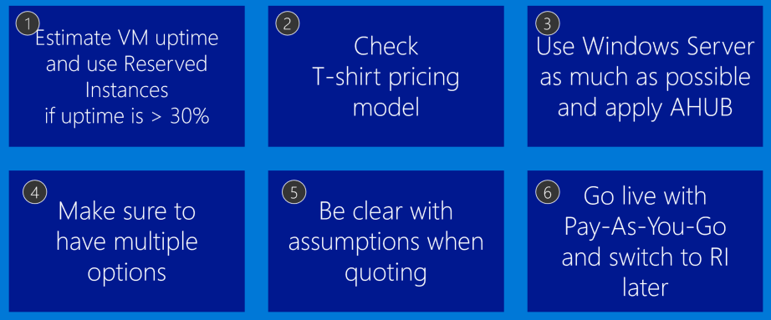
Azure Pricing Tips
Notes:
To further optimize the cost:
- Estimate VM uptime and use Reserved Instances if uptime is larger than 30%
- Review T-Shirt pricing model
- When using Windows Server, take advantage of the Azure Hybrid Use Benefits (AHUB)
- Schedule stopping and deallocating of non-production virtual machines during their idle times:
- This functionality is available directly from the Azure portal. Alternatively, you can use Azure Automation runbooks or custom Azure PowerShell and Azure CLI scripts to stop and deallocate any instance. The same techniques can be used to start the instance on a scheduled time.
- Note that the built-in platform auto-shutdown functionality does not provide the draining functionality of application servers, so it is important to verify that these servers do not have any active tasks before initiating shutdown. This can be implemented by using Azure Automation or Azure functions.

Slide 31
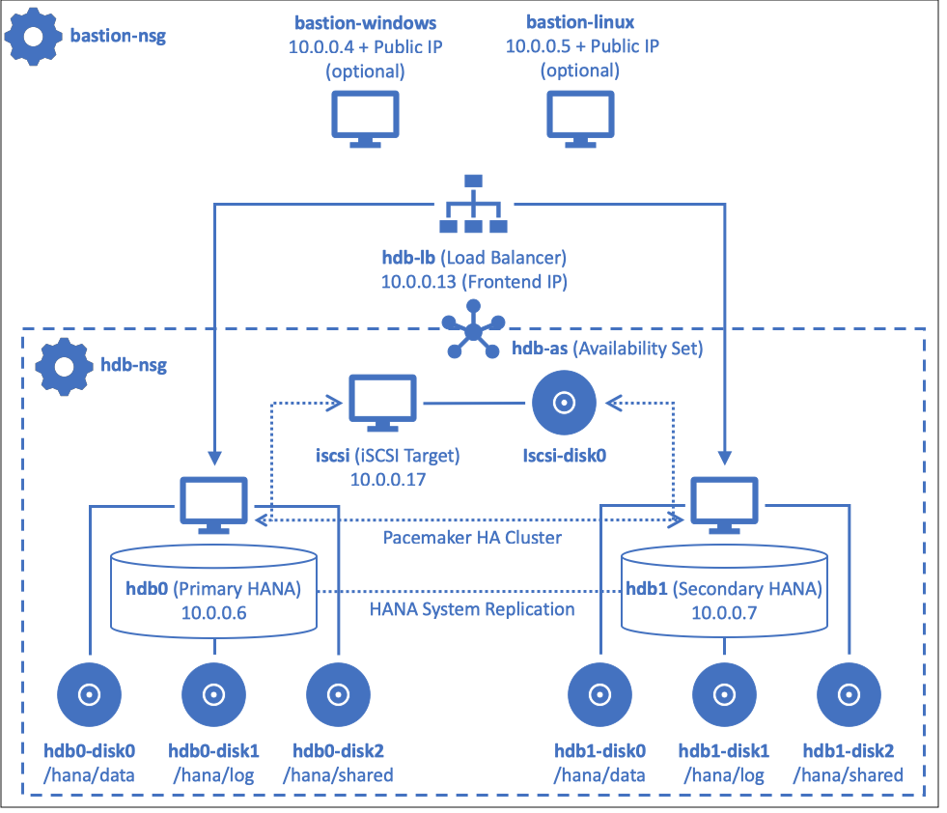
Automated deployment of HANA with Terraform and Ansible
Step-by-step Hands-on Lab guidance can be found here in Github
Notes:
Considering technologies used or intended to be used for on-premises deployments, the solution will leverage Ansible for configuration management and Terraform for Azure resource provisioning. The solution offers full automation capabilities, including both provisioning Azure resources, as well as installation and configuration of SAP HANA software components.

Slide 32
Roadmap
Azure Backup HANA support : Public preview
Azure Monitoring integration : Roadmap
Proximity Placement Group : Private preview
Azure NetApp Files : Certification for HANA (scale-up, scale-out) and support for Any DB in roadmap
Azure Files NFS support : Roadmap
Ultra SSD : Public preview, certification in roadmap
M416s, M416ms : Roadmap
Notes:
Review the roadmap and explain how upcoming changes might impact the proposed solution.

Slide 33
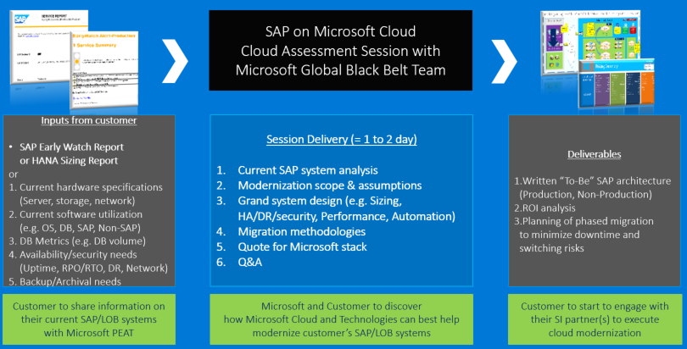
SAP on Azure - Cloud Assessment Session (= Architecture Design Session)
Notes:
Step through the process of carrying out a cloud assessment session

Slide 34




Go Dos and Resources
Learn
SAP on Azure Website
SAP on MS Platform blog
SAP on Azure – SAP Community Wiki
SAP HANA/NetWeaver on Azure Documentation
HANA on Azure Large Instances Architecture
SAP on Azure reference architecture
Microsoft Partner Network – SAP on Azure
Whiteboard Design Session and Hands-on Lab (HANA and Any DB)
How Microsoft IT runs SAP
SAP on Azure case study videos
SAP HANA Academy
Open SAP
SAP on Azure Infopedia Product Hub (Internal)
SAP on Azure roadmap (Internal/NDA)
Battlecards (Internal)
SAP on Azure Tech Community Call (Internal)
Touch
SAP Cloud Appliance Library
SAP HANA on Azure SUSE Linux templates
SAP HANA on Azure ARM templates
Ask
SAP on Azure Yammer (Internal)
Contact SAP Technical Community saptalk@microsoft.com
Engage
Contact : Americas SAP on Azure CoE SAPGBBAMERICAS@microsoft.com, EMEA SAP on Azure CoE SAPGBBEMEA@microsoft.com or Asia SAP on Azure CoE SAPGBBASIA@microsoft.com
Notes:
Verify that the resources referenced on this slide are up-to-date

Slide 35
Latest SAP HANA on Azure Content
Latest SAP HANA on Azure content can be found at : https://github.com/Microsoft/MCW-SAP-HANA-on-Azure
Notes:
Reference the latest version of the SAP HANA on Azure content before presenting this session.

Slide 36
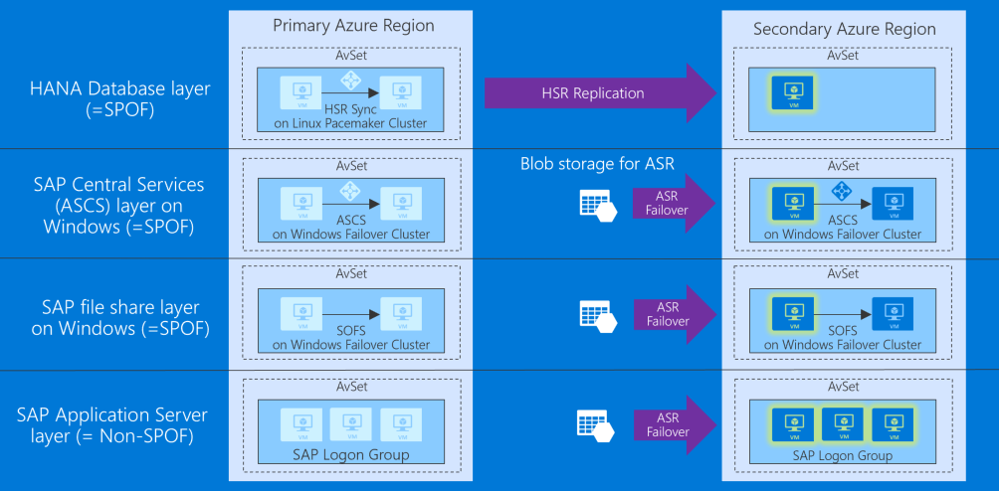
S/4HANA HA in Availability Set and DR across Regions (DR Failover)

Slide 37
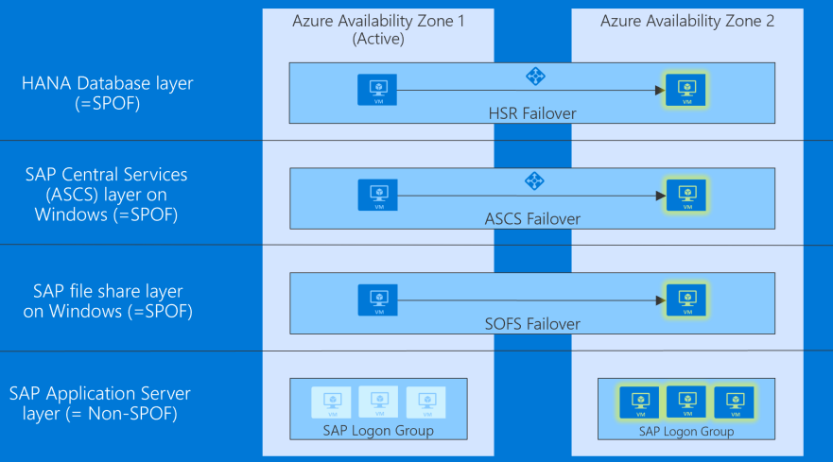
S/4HANA HA and DR across Availability Zones (DR Failover)

